Slide 1
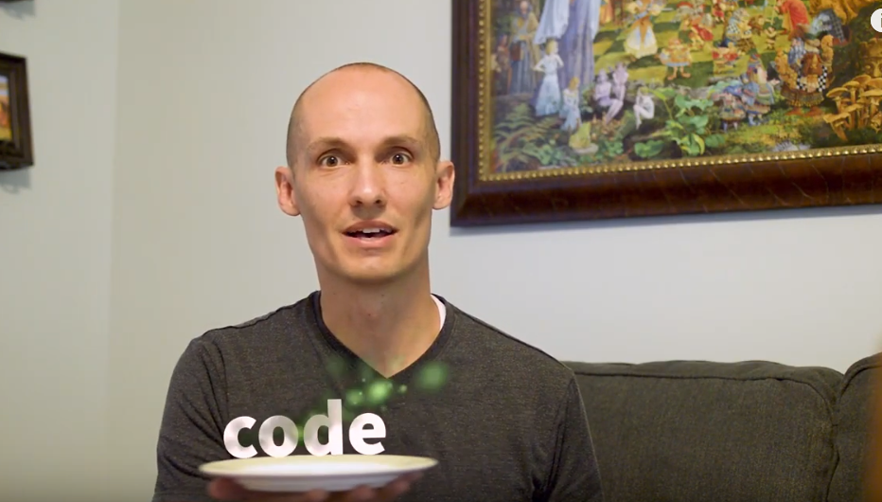
Code Smell
Submitted To
Falguni Roy
Assistant Professor
Institute of Information Technology
NSTU,3810
Submitted By
Md Mynuddin(ASH1825007M)
Al Adnan (ASH1825008M)
Kamruzzaman Shekh(ASH1825035M)

Slide 2
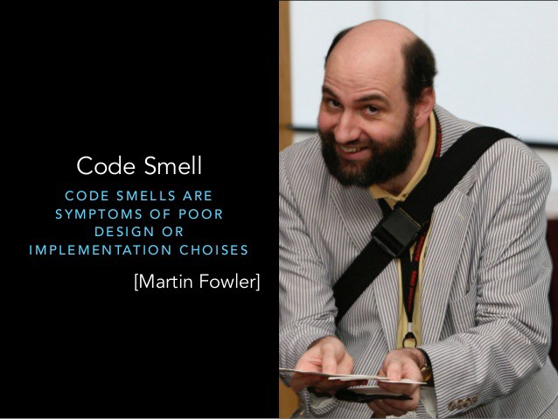
What is code Smell ?

Slide 3
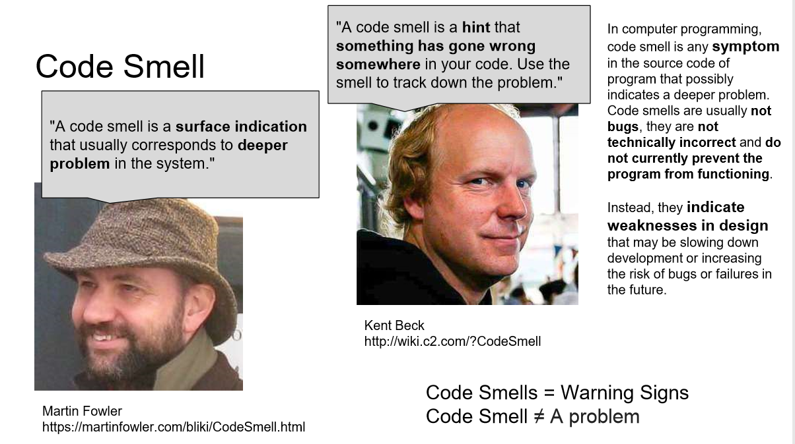

Slide 4
Common code smells
Application-level smells
Duplicated code
Contrived complexity
Shotgun surgery
Class-level smells
Large class
Feature envy
Inappropriate intimacy
Refused bequest
Excessive use of literals
Cyclomatic complexity
Downcasting
Data clump
Method-level smells
Too many parameters
Long method
Excessively long identifiers:
Excessively short identifiers
Excessive return of data
Excessively long line of code

Slide 5
Couplers
Excessive coupling between classes and methods leads to code smell that is categorized into coupling smells
Feature envy: Data of another object is made use of by a method, more than its own data. Such code smells after fields are moved to a data class.
Inappropriate intimacy: One class uses the internal fields and methods of another class.
Message chains: A code makes a series of calls, like one method calling another, and that method in turn calling another method: method1() > method2() > method3().
Middle man: If a class calls another class, and performs only the one function of calling the other class, then the middle class smells.

Slide 6
Feature Envy
Signs and Symptoms
A method accesses the data of another object more than its own data.
Reasons for the Problem
When a method makes too many calls to other classes to obtain data or functionality, Feature Envy is in the air. This smell may occur after fields are moved to a data class

Slide 7

Feature Envy
Treatment
If a method clearly should be moved to another place, use Move Method.
If only part of a method accesses the data of another object, use Extract Method to move the part in question.
If a method uses functions from several other classes, first determine which class contains most of the data used. Then place the method in this class along with the other data. Alternatively, use Extract Method to split the method into several parts that can be placed in different places in different classes.

Slide 8
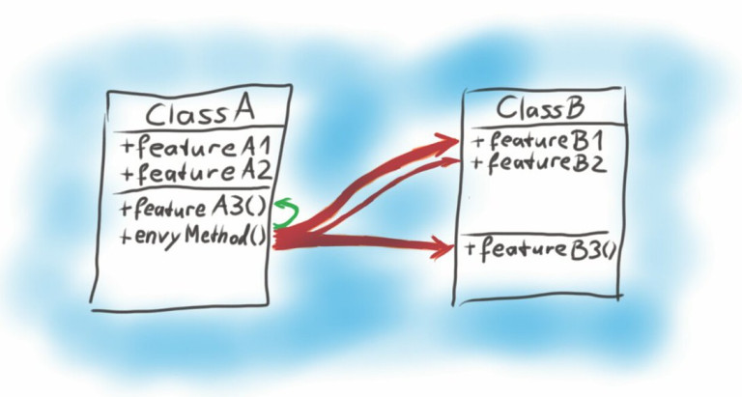
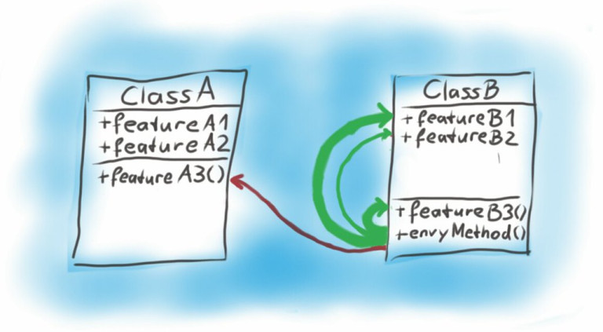
Feature Envy Example

Slide 9
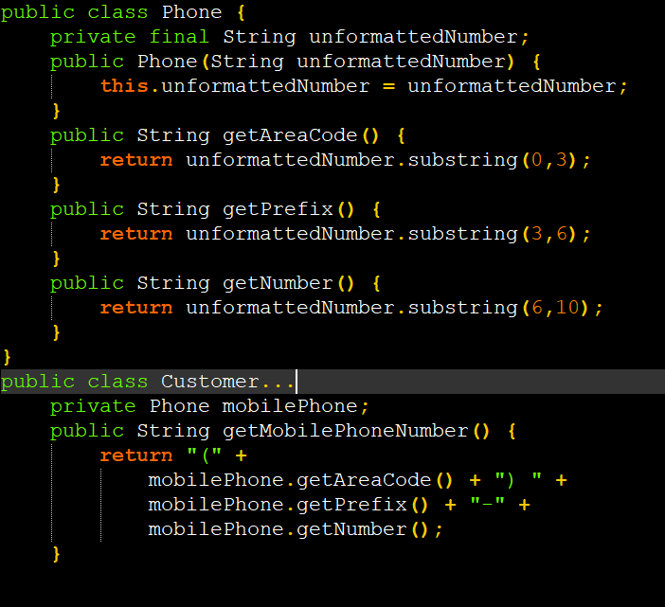
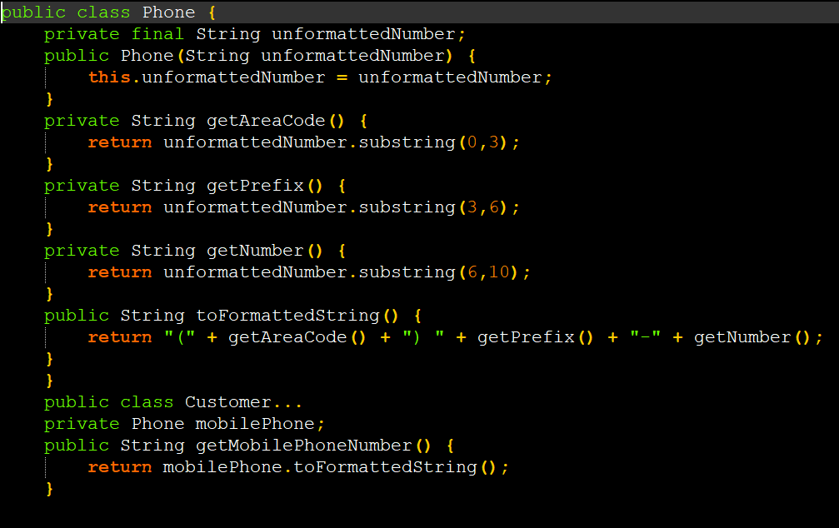
Feature Envy Example
With Feature Envy
Without Feature Envy

Slide 10
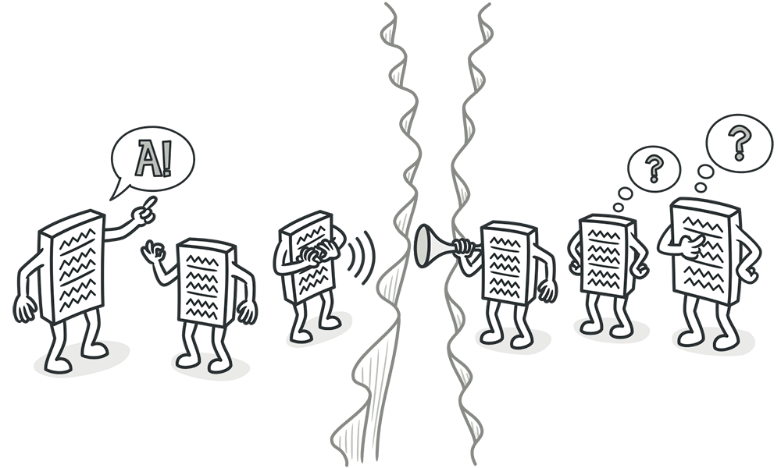
Message Chains
Signs and Symptoms
In code you see a series of calls resembling $a->b()->c()->d()

Slide 11
Message Chains
Reasons for the Problem
A message chain occurs when a client requests another object, that object requests yet another one, and so on.
These chains mean that the client is dependent on navigation along the class structure. Any changes in these relationships require modifying the client.

Slide 12
Message Chains
Treatment
To delete a message chain, use Hide Delegate.
Sometimes it’s better to think of why the end object is being used. Perhaps it would make sense to use Extract Method for this functionality and move it to the beginning of the chain, by using Move Method.
Payoff
Reduces dependencies between classes of a chain.
Reduces the amount of bloated code

Slide 13
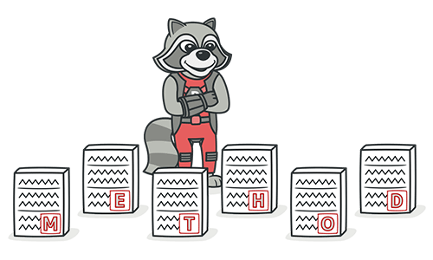
Inappropriate Intimacy
One class uses the internal fields and methods of another class.

Slide 14
Remedies
Move Method
Move Field
Extract Class
Change Bidirectional Association to Unidirectional
Replace Delegation with Inheritance

Slide 15
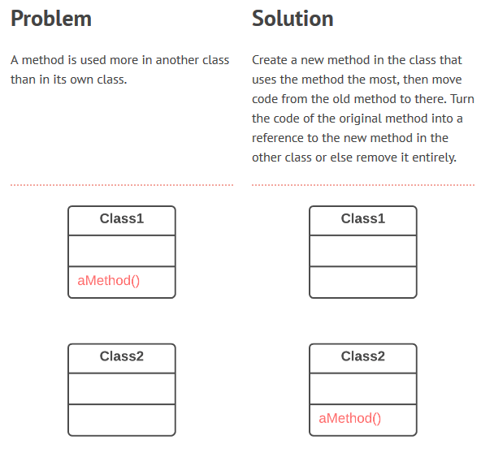
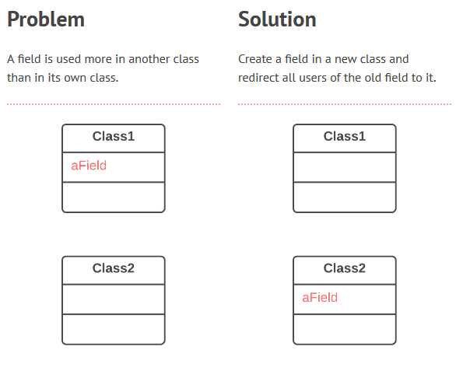
Move method and Move Field

Slide 16
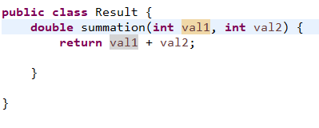
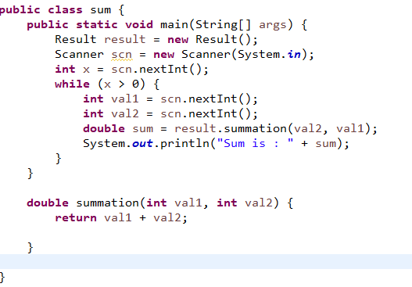
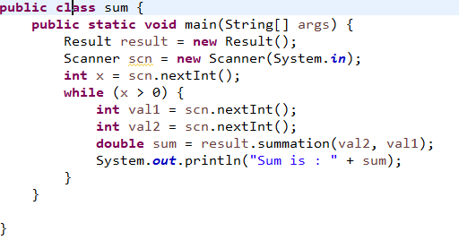
Continue

Slide 17
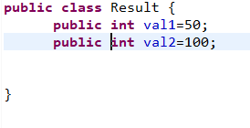
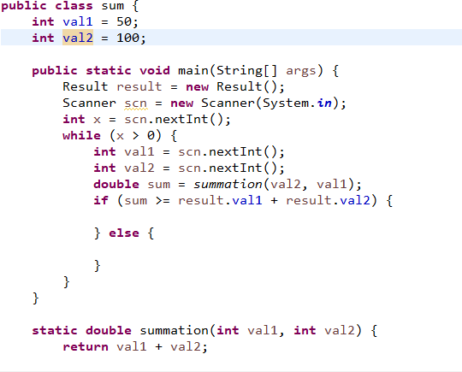
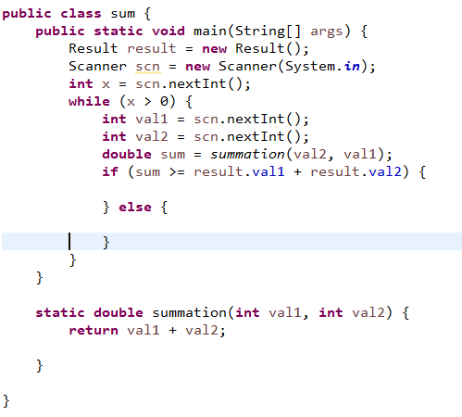
Continue

Slide 18
Why Refactor
You want to move a method to a class that contains most of the data used by the method. This makes classes more internally coherent.
You want to move a method in order to reduce or eliminate the dependency of the class calling the method on the class in which it’s located. This can be useful if the calling class is already dependent on the class to which you’re planning to move the method. This reduces dependency between classes.

Slide 19
Benefits
This refactoring method will help maintain adherence to the Single Responsibility Principle. The code of your classes will be more obvious and understandable.
Single-responsibility classes are more reliable and tolerant of changes. For example, say that you have a class responsible for ten different things. When you change this class to make it better for one thing, you risk breaking it for the nine others.

Slide 20
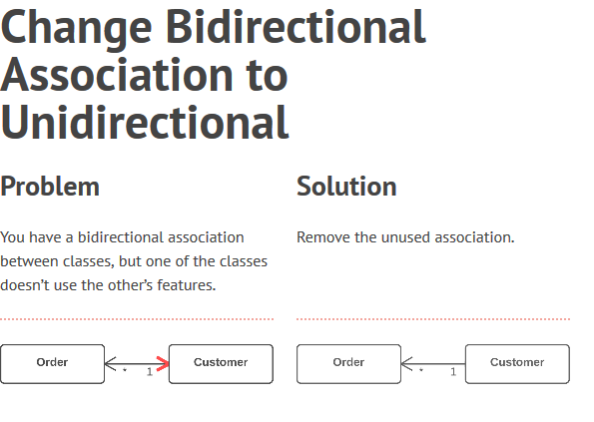
Change Bidirectional Association to Unidirectional

Slide 21
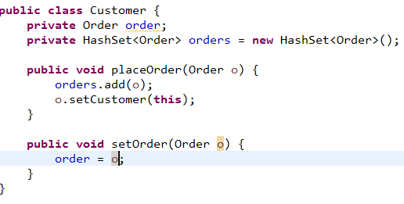
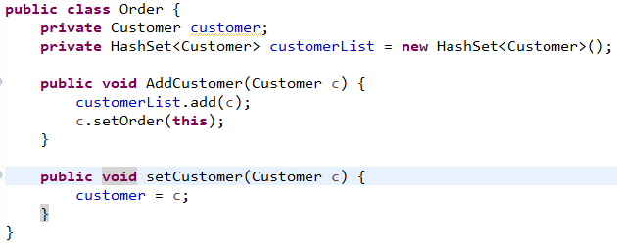
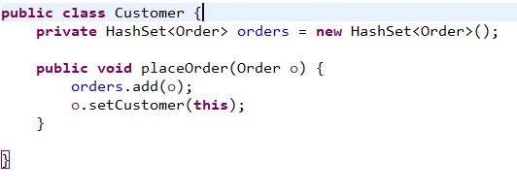
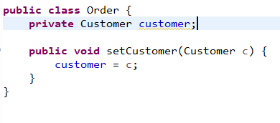
Continue

Slide 22
Benefits
Simplifies the class that doesn’t need the relationship. Less code equals less code maintenance.
Reduces dependency between classes. Independent classes are easier to maintain since any changes to a class affect only that class.

Slide 23
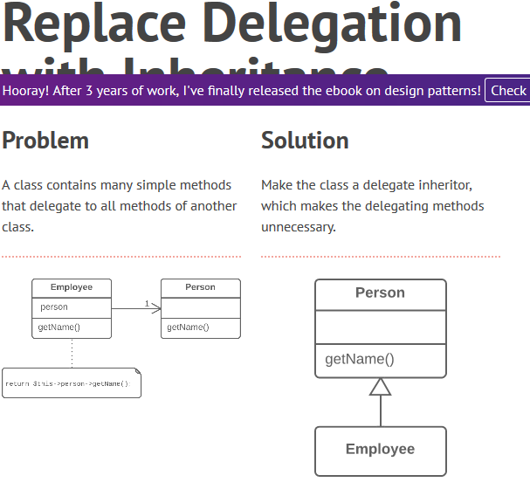
Replace Delegation with Inheritance

Slide 24
Benefits
Reduces code length.
All these delegating methods are no longer necessary.

Slide 25
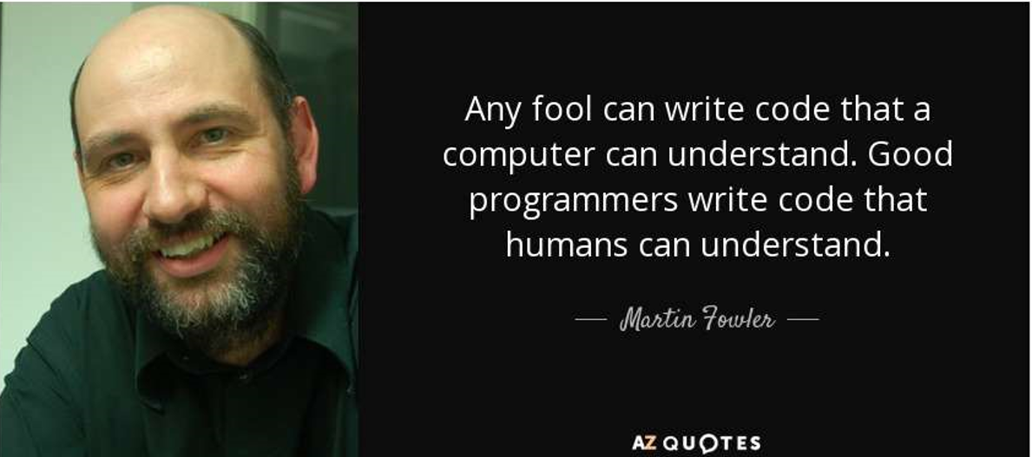
THANK YOU ☺

